Slide 1
Gig Planner CRUD App
M Bulfin

Slide 2
Brief
The objective of this project is to create a web application in python that has functionality to create, read update and delete information.
Project
I have decided to create an application that will be a Gig Planner. The user will be able to create a plan of upcoming gigs by adding a venue and a band

Slide 3
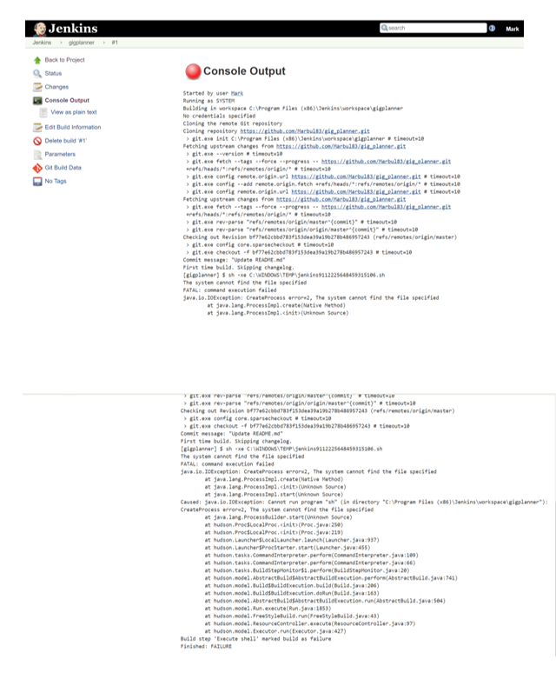

Slide 4
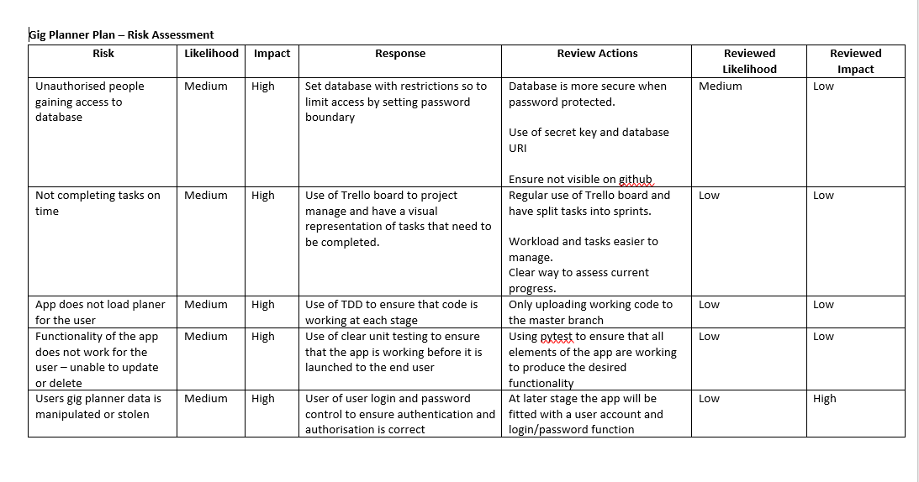

Slide 5
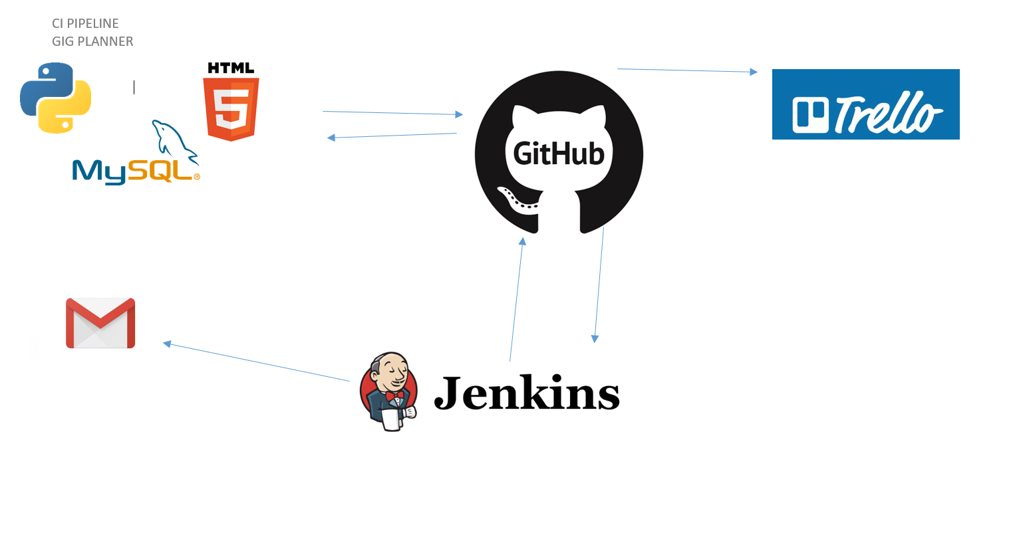

Slide 6
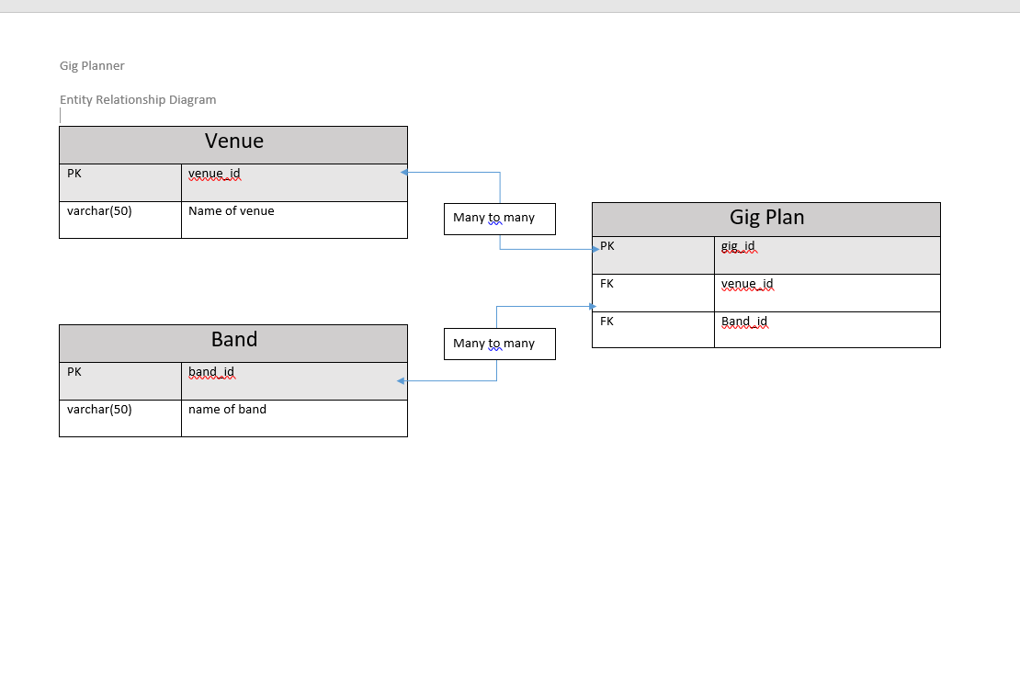

Slide 7
